Slide 1
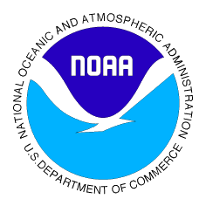

Lesson 3:
Ocean Acidification
Chemical Oceanography

Slide 2
Carbon is an important part of ocean chemistry
The ocean absorbs carbon dioxide from the atmosphere
Human activities release carbon dioxide into the atmosphere
Too much carbon dioxide in the ocean has the potential to harm marine organisms and ecosystems

Slide 3
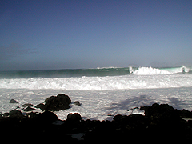
The ocean is a carbon sink
The ocean absorbs CO₂ from the atmosphere
Physical and biological processes move some of the carbon to the deep ocean where it is stored
The capture and
storage of carbon
is known as
carbon sequestration
Photo: NOAA
Our ocean
captures and stores carbon
Notes:
Photo:
NOAA, http://oceanservice.noaa.gov/education/pd/oceans_weather_climate/ocean_basics.html; Accessed: November 2010

Slide 4
How much CO₂ can the ocean absorb?
The total amount of any gas seawater can absorb depends on temperature and salinity
Salinity is a measure
of the dissolved salt (ion)
content of water
Remember this relationship!
Temperature
or
Salinity
Amount of gas
seawater can absorb
Notes:
Teacher’s Note: Increases in temperature and salinity can decrease the amount of gas seawater can absorb.

Slide 5
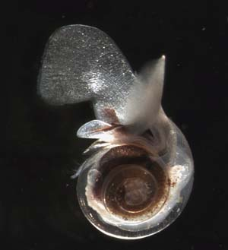
Carbon dioxide in the ocean
Photo: NOAA
When dissolved in water, carbon dioxide forms carbonic acid that primarily dissociates into bicarbonate and hydrogen ions
Some of the excess hydrogen ions combine with carbonate, decreasing carbonate availability to marine organisms.
Carbonate is used by marine organisms like this pteropod (marine snail) to create the compound calcium carbonate
Calcium carbonate is the material that composes the shells and exoskeletons of many marine organisms
Notes:
Teacher’s Note: In reference to the first and second bullets, you may want to remind student that pH is a measure of the Hydrogen ion concentration. If the concentration of Hydrogen ions in seawater increases, the pH of seawater will decrease.
Photo:
NOAA, http://www.noaanews.noaa.gov/stories2006/s2606.htm; Accessed November 2010

Slide 6
Remember your pH scale
pH= -log[H⁺], so the lower the pH, the more H⁺
Remember your pH scale from chemistry:
acidic
(high H⁺ )
basic
(low H⁺ )
neutral
0
7
14
Vinegar
~3
Ocean water
~8
Ammonia
~11

Slide 7



Humans affect the amount of CO₂ in the ocean
Transportation, industry and things we do at home, like use electricity, have contributed to rising CO₂ emissions to the atmosphere, which are then absorbed by the ocean

Slide 8
Ocean pH levels are decreasing
Data from scientists show that average ocean pH has decreased between the 1700s (pre-industry) and the 2000s
Observations at monitoring stations across the ocean have shown this decreasing trend
Decreasing pH = more acidic
Notes:
Teacher’s note:
You can find descriptions of the data at the link below:
http://coralreefwatch.noaa.gov/satellite/oa/description/oaps_intro_oa.html; Accessed: November 2010

Slide 9
Student activity
What impacts might increased ocean acidity have on marine life?
We will explore some of these impacts in our activity

Slide 10
Wrap-up: How is marine life affected?
As you saw in the exercise, CaCO₃ is broken down in acidic solution
Shells of marine life can begin to dissolve in high CO₂ concentrations.
Notes:
For additional information:
http://www.noaanews.noaa.gov/stories2006/s2606.htm; Accessed November 2010
http://oceanservice.noaa.gov/news/weeklynews/dec08/acidification.html; Accessed November 2010

Slide 11
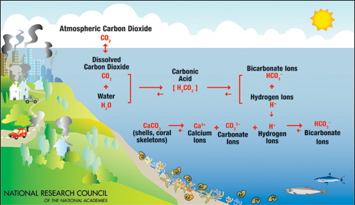

Slide 12
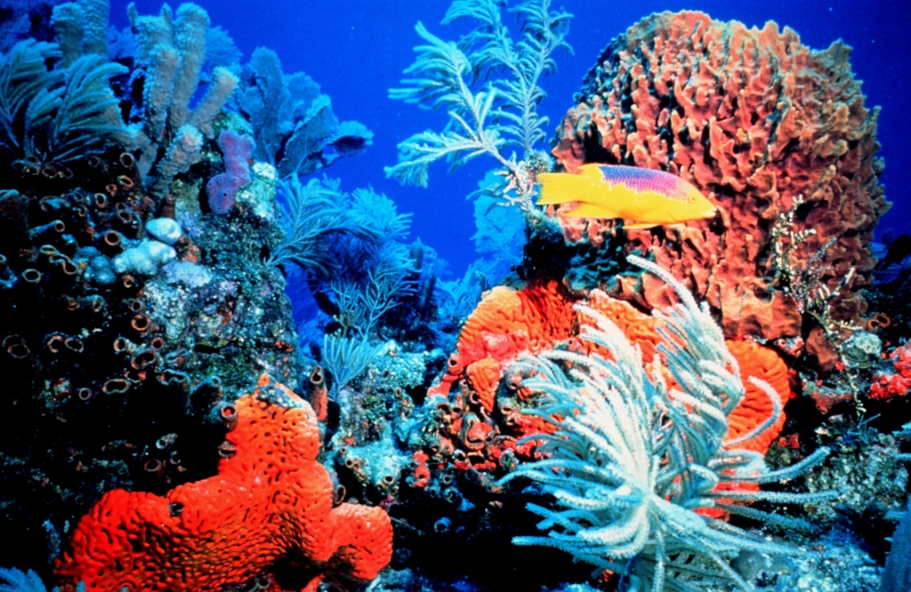
How is marine life affected?
Sensitive ecosystems like coral reefs may decline due to change in pH and slower construction of coral exoskeletons.
Photo: NOAA
Notes:
Photo:
NOAA, http://www.noaa.gov/features/green/iyor.html; Accessed November 2010

Slide 13

How is marine life affected?
Reduced abundance of small shelled organisms may cause problems for those larger species that prey upon them for food
Interference with marine
mammal communication
is possible!
Photo: NOAA
Notes:
Teacher’s Note: If you want to give students an example of pH interference with marine mammal communication, direct them to the story at the following link: http://www.abc.net.au/science/articles/2008/10/01/2379032.htm
Photo:
NOAA, http://www.noaanews.noaa.gov/stories2009/20090311_dolphinpsa.html; Accessed November 2010

Slide 14
https://www.youtube.com/watch?v=xuttOKcTPQs

